Slide 1

BIRD IMAGE RETRIVAL AND RECOGNITION
Under the esteemed guidance of
Sk.Rafi,M.Tech.,(Ph.D)
Team members
N.Bhargava Raju : 19471A05N3
Ch.Shanmukha Chakravarthy :19471A05K6
D.Balaji : 19471A05K9

Slide 2
ABSTRACT
Birdwatching is a common hobby but to identify their species requires the assistance of bird books. To provide birdwatchers a handy tool to admire the beauty of birds, we developed a deep learning platform to assist users in recognizing 27 species of birds endemic to Taiwan using a mobile app named the Internet of Birds (IoB).
Bird images were learned by a convolutional neural network (CNN) to localize prominent features in the images.
First, we established and generated a bounded region of interest to refine the shapes and colors of the object granularities and subsequently balanced the distribution of bird species.
Then, a skip connection method was used to linearly combine the outputs of the previous and current layers to improve feature extraction. Finally, we applied the softmax function to obtain a probability distribution of bird features.
The proposed CNN model with skip connections achieved higher accuracy of 99.00 % compared with the 93.98% from a CNN and 89.00% from the SVM for the training images.

Slide 3
SYSTEM REQUIREMENTS
HARDWARE REQUIREMENTS
Processor : Intel(R) Core™2 i7-5500U CPU @2.50GHz
RAM : 8GB(gigabyte)
System Type : 64-bit operating system, x64-based processor
SOFTWARE REQUIREMENTS
Browser : Any Latest browser like Chrome
Operating System : Windows 10
Language : Python
Platform : Google COLAB

Slide 4
EXISTING SYSTEM
The existing system usually for a of bird image retrieval and recognition:
The first phase is image pre-processing once you have acquired images, the next step is to pre-process them to prepare them for recognition.
The second phase is Feature extraction: This step involves extracting relevant features from the pre-processed images. These features are used to represent the image and are used in the recognition process. Common features include color histograms, edge detection, and textures.
The final phase is Recognition: Using the trained model, new images can be passed through the model to recognize the species of birds present in the images. The model will output the species of bird along with a confidence score indicating the model's confidence in its prediction.

Slide 5
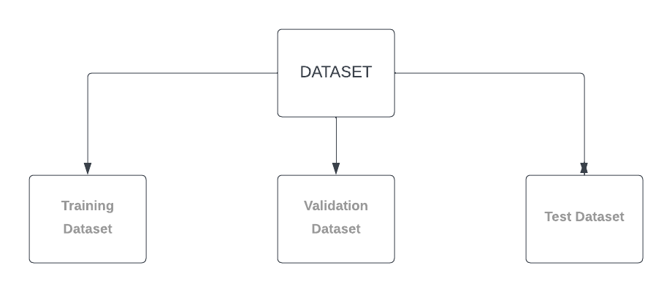
DATASET
Structure of the dataset:

Slide 6
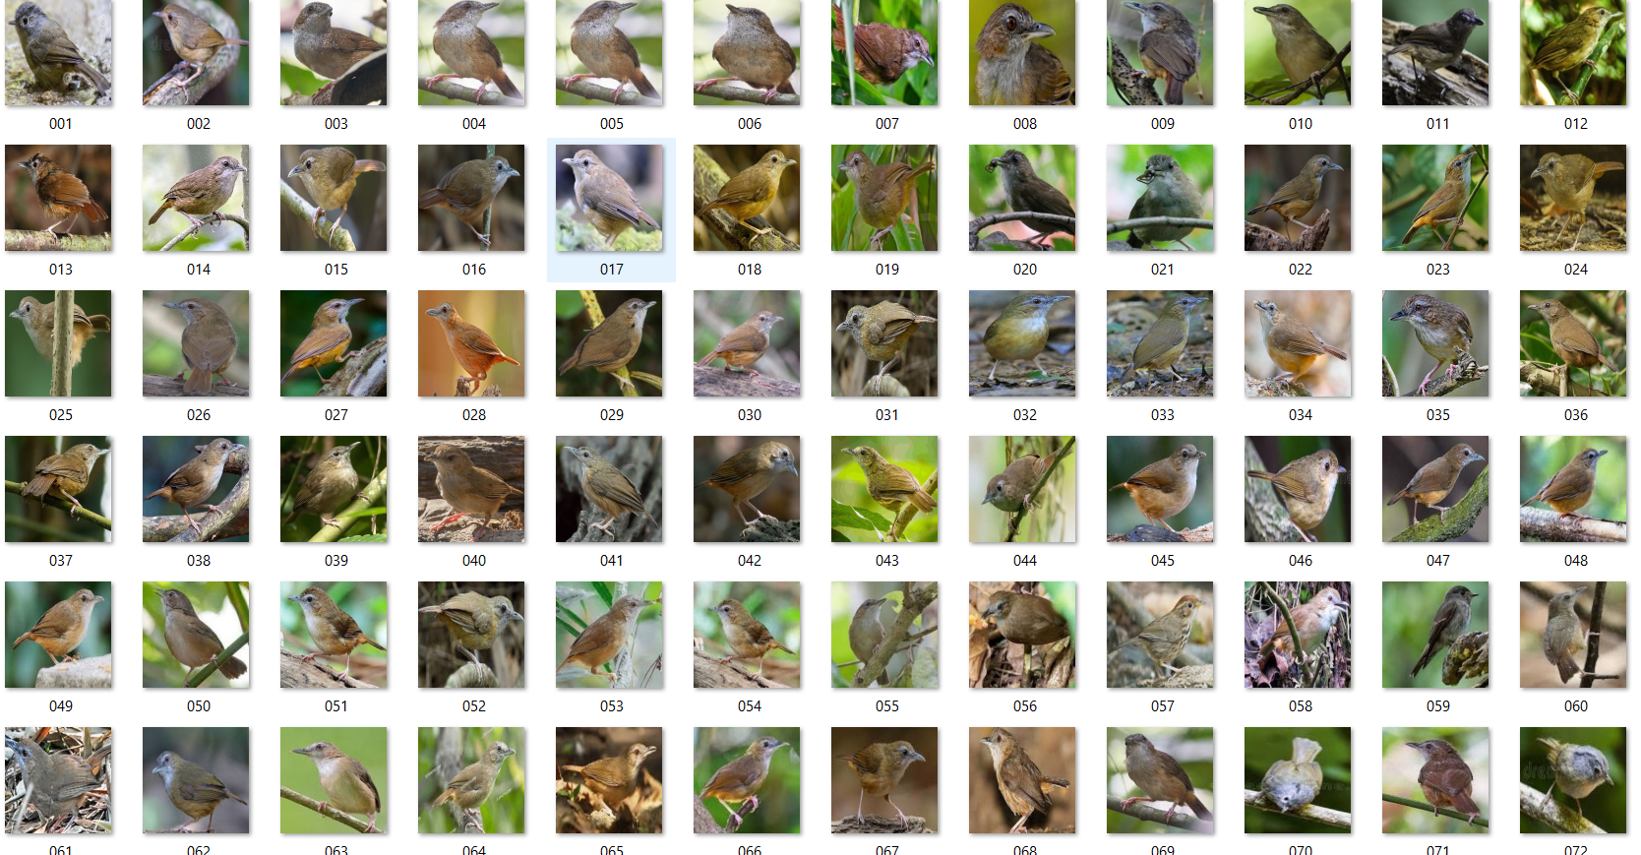
TRAIN

Slide 7
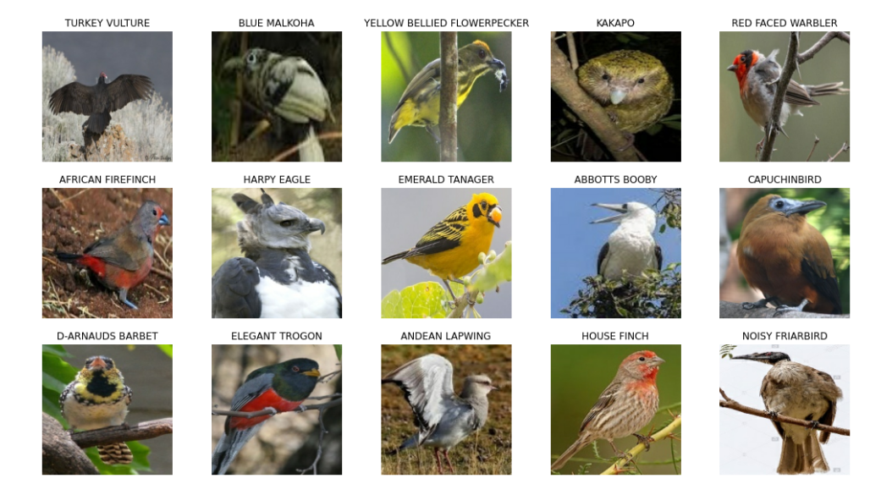
VALIDATION

Slide 8
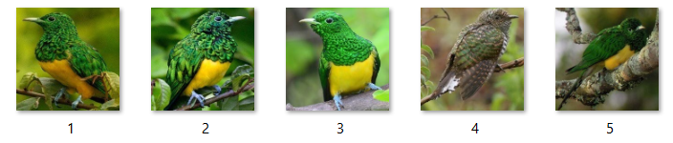
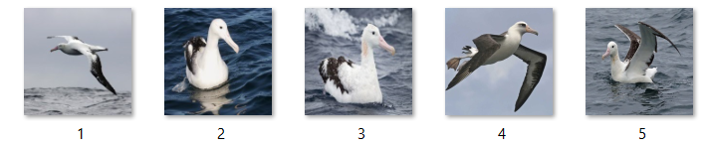
TEST

Slide 9
PRE-PROCESSING
The necessary modifications that have been performed on the dataset to increase the overall performance, accuracy is known as pre-processing.
Image pre-processing is the term for operations on images at the lowest level of abstraction. These operations do not increase image information content but they decrease it if entropy is an information measure.
Before feeding the entire dataset to the model, we preprocess the data by using the default builtin functions like nasnet_preprocessor, xception_preprocessor, etc,. This work by scaling the input pixels between -1 and 1.
Finally, we convert the images to tensors to process the input.

Slide 10
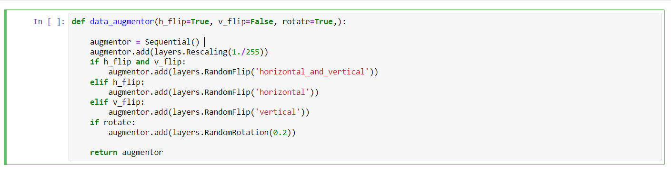
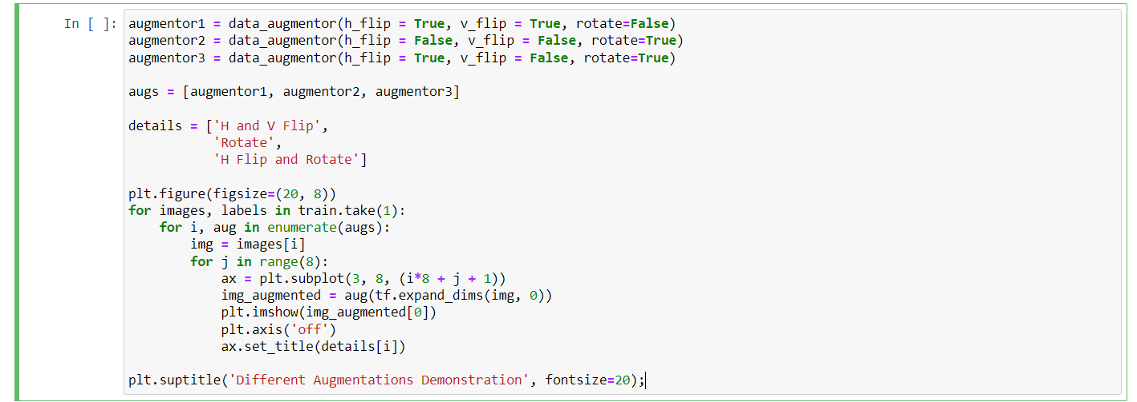

Slide 11
IMPORTED MODULES
import numpy as np
import pandas as pd
import tensorflow as tf
import matplotlib.pyplot as plt
import seaborn as sns
from tensorflow.keras import layers
from tensorflow.keras.preprocessing import image_dataset_from_directory
from tensorflow.keras import Sequential
from tensorflow.keras.applications.mobilenet_v2 import MobileNetV2
from tensorflow.keras.callbacks import ModelCheckpoint
import warnings
warnings.filterwarnings('ignore')

Slide 12
CNN algorithm
inputs = tf.keras.Input(shape = IMAGE_SHAPE)
x = augmentor3(inputs)
x = mobile_base(x)
x = layers.GlobalAveragePooling2D()(x)
x = layers.BatchNormalization()(x)
x = layers.ReLU()(x)
x = layers.Dropout(0.25)(x)
x = layers.Dense(1500)(x)
x = layers.BatchNormalization()(x)
x = layers.ReLU()(x)
x = layers.Dropout(0.25)(x)
x = layers.Dense(1200)(x)
x = layers.BatchNormalization()(x)
x = layers.ReLU()(x)
x = layers.Dropout(0.25)(x)
x = layers.Dense(900)(x)
x = layers.BatchNormalization()(x)
x = layers.ReLU()(x)
x = layers.Dropout(0.25)(x)
outputs = layers.Dense(450, activation='softmax')(x)
model = tf.keras.Model(inputs, outputs)
model.summary()

Slide 13
Training the model
optimizer_1 = tf.keras.optimizers.Adam(learning_rate = LEARNING_RATE)
loss = tf.keras.losses.CategoricalCrossentropy(from_logits=False)
model_checkpoint = ModelCheckpoint(MODEL_CHECKPOINT_FILEPATH,
monitor='val_accuracy',
save_best_only=True,
save_weights_only=True,
verbose=1,
mode = 'max')
callbacks = [model_checkpoint]
model.compile(optimizer = optimizer_1,
loss = loss,
metrics=['accuracy'])
history = model.fit(train,
validation_data=valid,
epochs=ROUND_1_EPOCHS,
callbacks = callbacks)

Slide 14
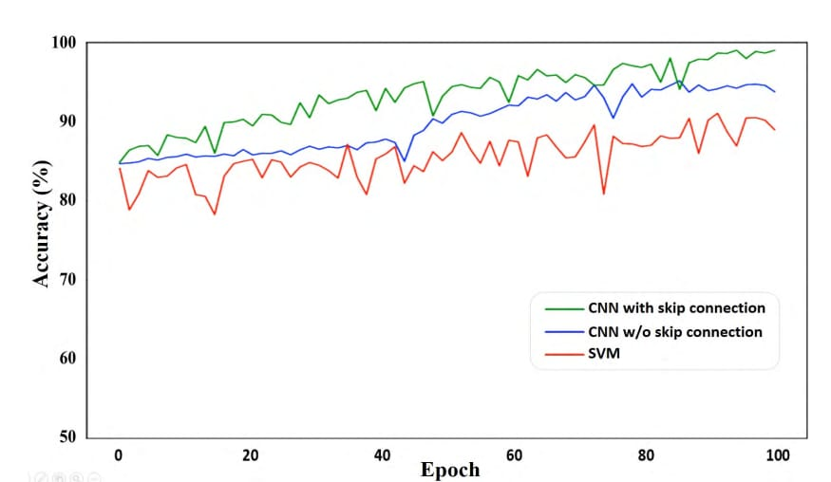
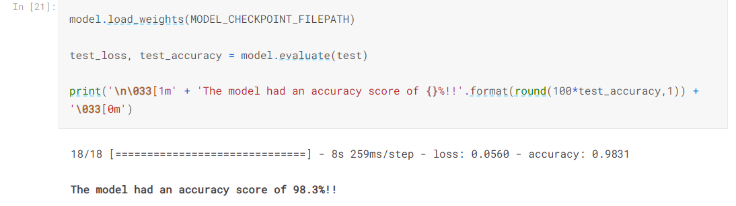
Testing and Accuracy
Accuracy in base paper
Validation accuracy:95.37%
Testing accuracy :96.11%
Accuracy of my project
Validation accuracy:98.31%
Testing accuracy :99.11%

Slide 15
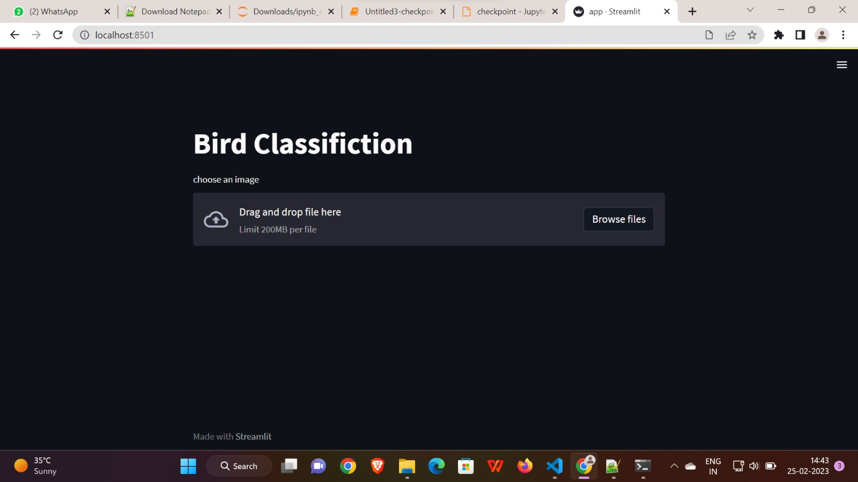
Project Screenshots

Slide 16
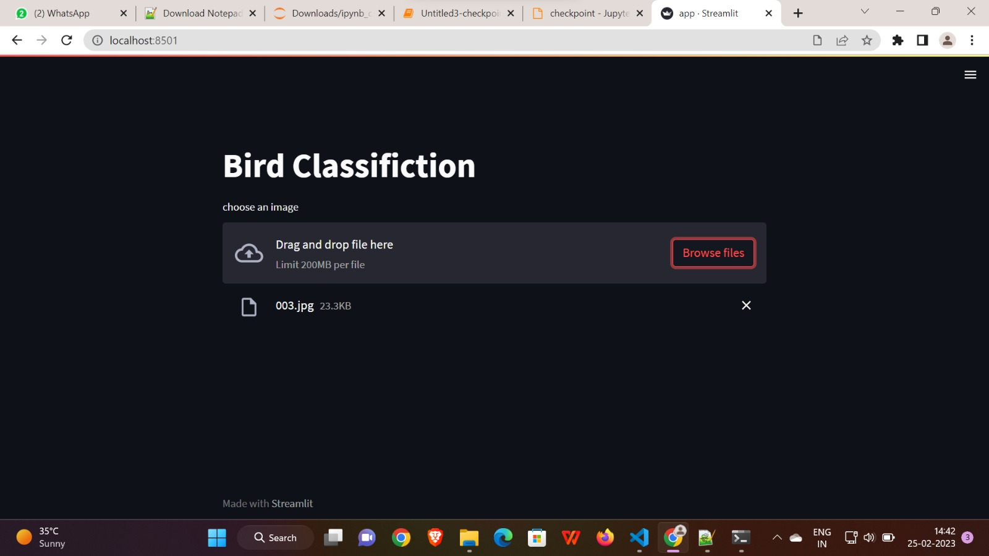

Slide 17
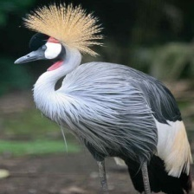
AFRICAN CROWNED CRANE

Slide 18
CONCLUSION
Bird image retrieval and recognition is a challenging problem that requires the development of robust and accurate algorithms, as well as large datasets of annotated images. The recent progress made in deep learning, especially in CNNs, has led to significant advances in this field, and these techniques are now being used to build large datasets of birds.
Future research will likely focus on further improving the accuracy of these algorithms and developing more effective ways to collect and annotate large datasets of bird images.

Slide 19
THANK YOU

